Slide 1
ANDROID BOOTING PROCESS

Slide 2
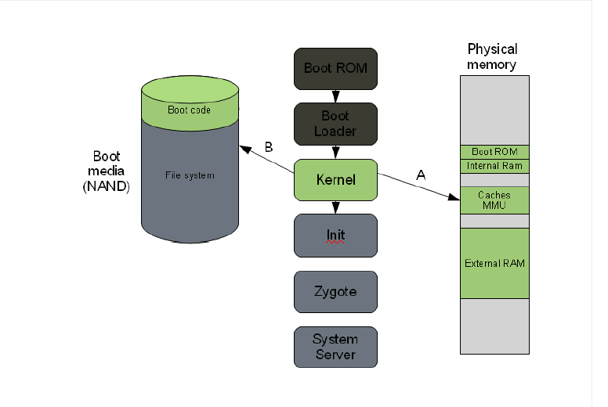
LINUX KERNEL:

Slide 3
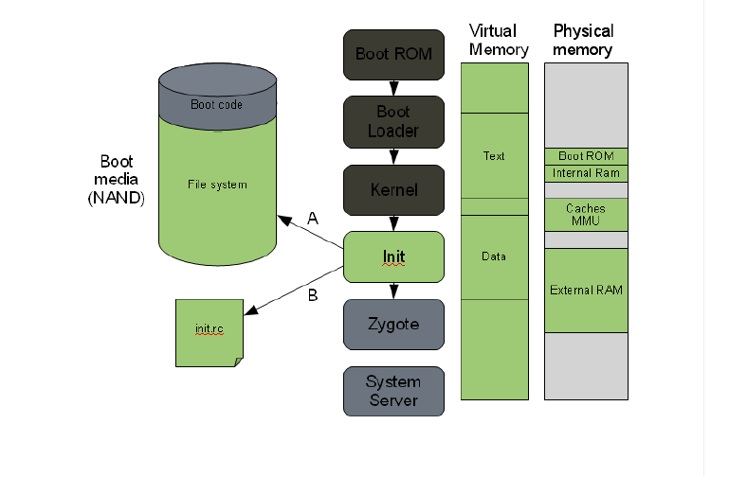
.
INIT PROCESS

Slide 4
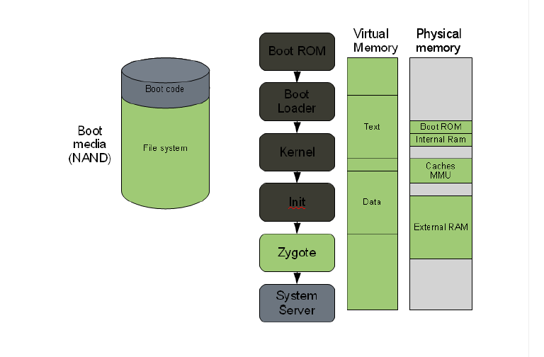
.
ZYGOTE & DALVIK

Slide 5
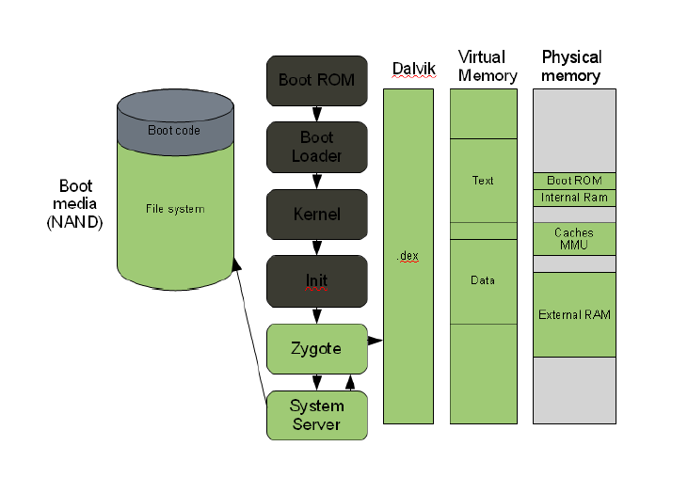
.
SYSTEM SERVER

